Slide 1


Cyngor Bwrdeistref Sirol Pen-y-bont ar Ogwr
Bridgend County Borough Council
Y Gyfarwyddiaeth Addysg, Blynyddoedd Cynnar
a Phobl Ifanc
Education, Early Years and Young People Directorate
Online Safety for families
www.bridgend.gov.uk
www.bridgend.gov.uk
Notes:
START SLIDE

Slide 2
Objective
To understand the benefits of modelling responsible screen time habits
To understand why online age restrictions exist
To understand the risks of social media.
To understand our online responsibilities.
Create a family agreements for our devices and our time spent online.
Notes:
CONTENT SLIDE

Slide 3
Screentime
www.bridgend.gov.uk
www.bridgend.gov.uk
Notes:
START SLIDE

Slide 4

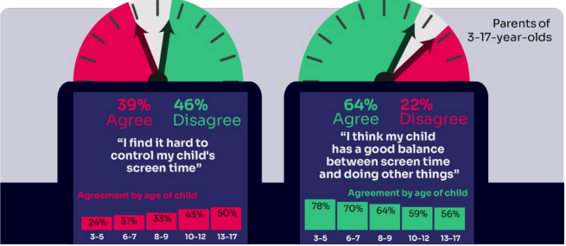

WORRIED about their SCREENTIME? How do you MANAGE this?
Know HOW LONG YOUR CHILD SPENDS online daily?
Children spent an average 3 hours 5 minutes per day accessing the internet via smartphones/tablets/computers
Four in ten (39%) parents of children aged 3-17 report finding it hard to control their child’s screentime
www.bridgend.gov.uk
Notes:
CONTENT SLIDE

Slide 5
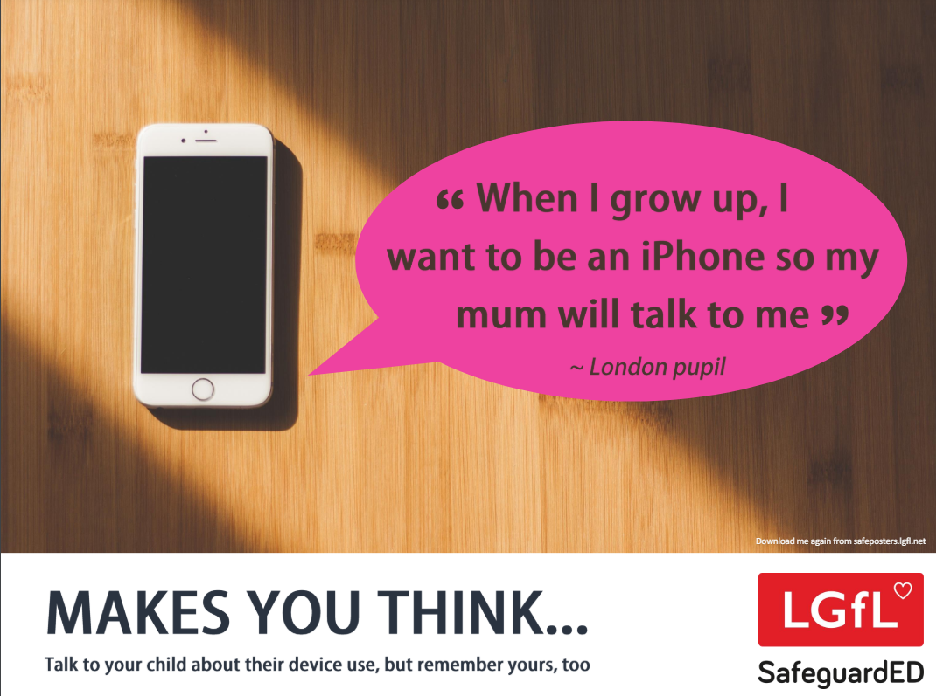
How does your child feel about YOUR SCREENTIME vs THEIRS?
52% of 8-11s feel that their parents’ screentime is too high
33% of 8-17s feel that their own screentime is too high
www.bridgend.gov.uk
Notes:
CONTENT SLIDE

Slide 6
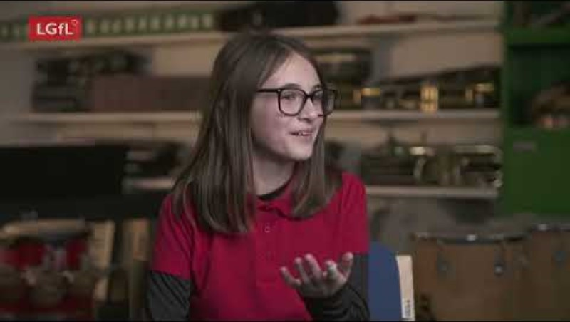
www.bridgend.gov.uk
Notes:
CONTENT SLIDE

Slide 7
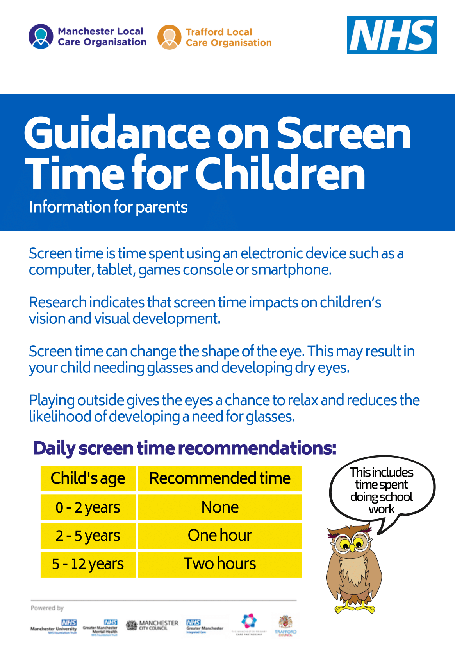
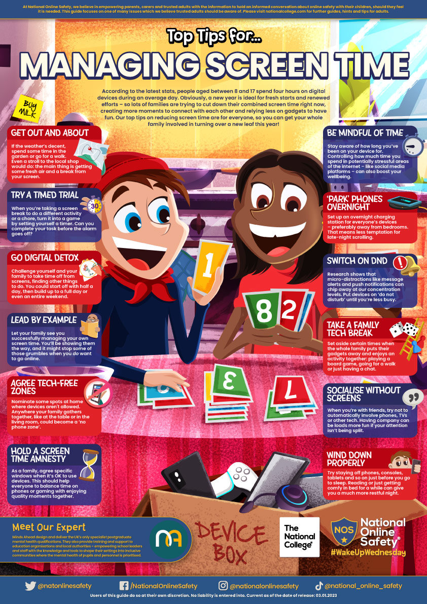
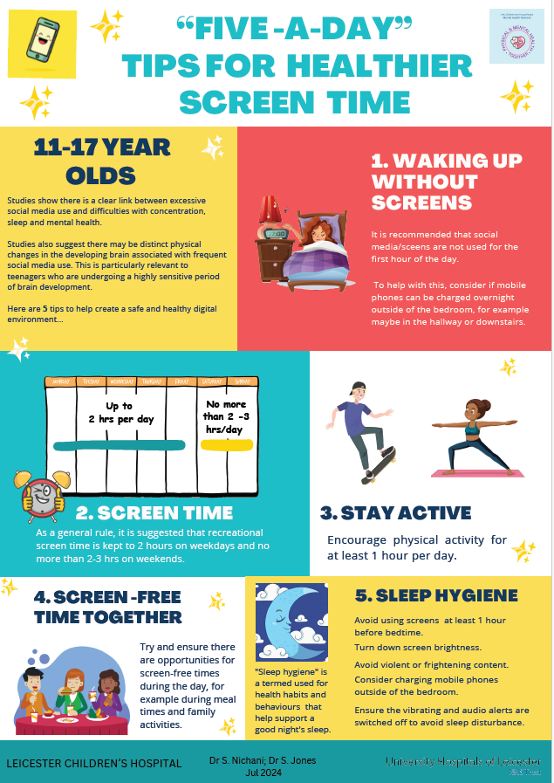
Children and Young People with screentime - A Good Start
Resources for parents and carers to help children get off to a good start using digital devices
Screentime - A Good Start
A short guide for parents and carers – screentime
www.bridgend.gov.uk
Notes:
CONTENT SLIDE

Slide 8
Online age-restriction
www.bridgend.gov.uk
Notes:
START SLIDE

Slide 9
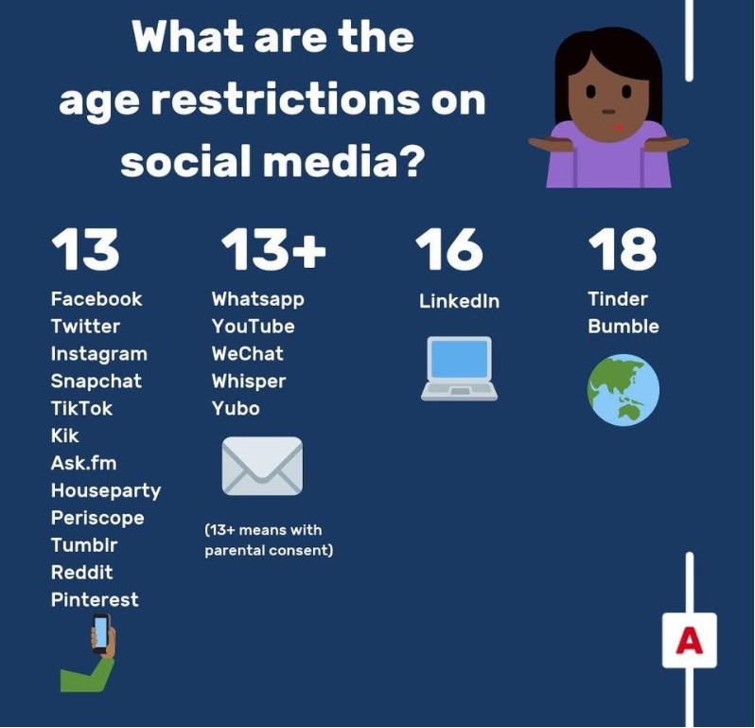

Mobile app age restriction – Why are there age limits imposed on mobile apps?
The primary reason – age requirements are there because of data protection laws.
Online services are not allowed to collect or store children’s personal information, if they are under the age of 13 without parental consent.
Data protection laws also say that only children aged 13 and over can sign up to some online services without parental permission.
?
https://www.ceopeducation.co.uk/parents/articles/is-my-child-ready-for-social-media
www.bridgend.gov.uk
Notes:
CONTENT SLIDE

Slide 10
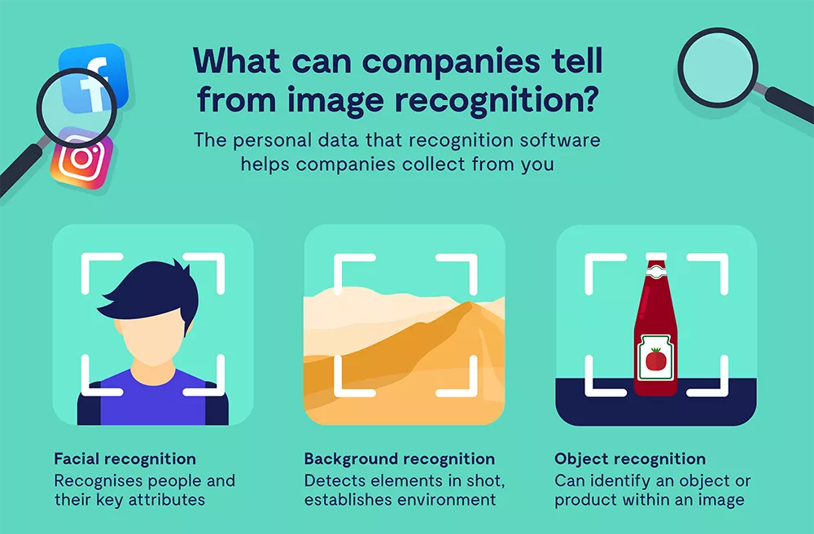
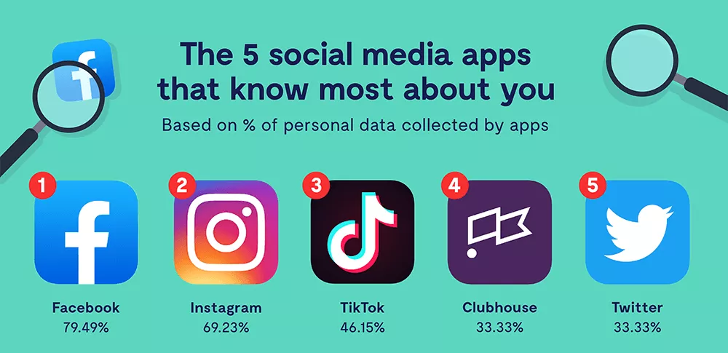
Collecting yours and your child’s data
Some of the data that companies collect from you:
location (visual or digitally captured) apps / games / services you use content you interacted with (adverts…) browser and device type credit / financial information contact details (email address…) engagement with other services metadata (time of day…) names, associated, friends, colleagues geolocation | phone number profile visits your social interactions followers / following… hashtag usage messages (non encrypted…) usernames and passwords photos, videos, uploads, downloads purchase history, shopping habits voice and face recognition
www.bridgend.gov.uk
Notes:
CONTENT SLIDE

Slide 11
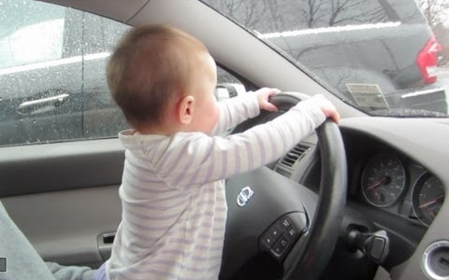

Why are there age limits for online apps, games and websites?
Age restrictions and age limits are there to protect us!
Comply with laws: In the UK, the legal age for children to give consent for their personal data to be collected by an online service is 13 years old.
Protect privacy: Young users may not understand the risks of sharing personal information. Children often give away personal information.
Safeguard mental health and wellbeing: Limit exposure to inappropriate, harmful content and addictive features within social media and gaming services.
Ensure content suitability: Prevent access to inappropriate content. Online services (apps and software) algorithms deliver age relevant content, and some content can be inappropriate and upsetting.
www.bridgend.gov.uk
Notes:
CONTENT SLIDE

Slide 12
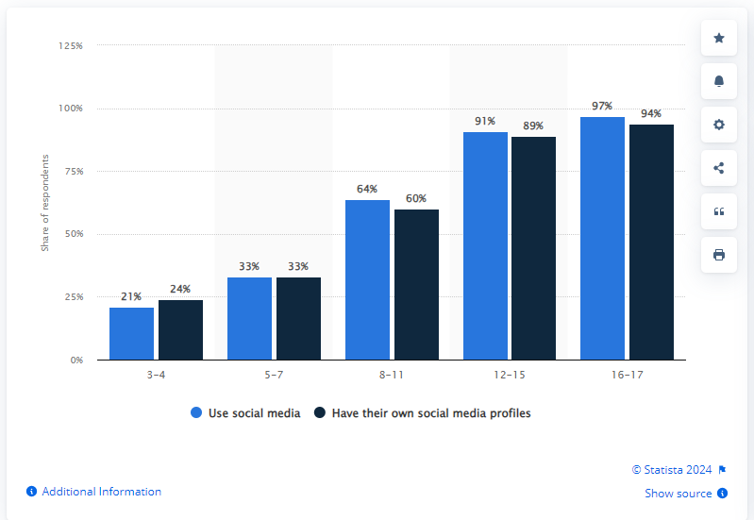
Social media profiles – underage children?
www.bridgend.gov.uk
Notes:
CONTENT SLIDE

Slide 13
Age restriction: consequences of falsifying age
Underaged children’s data will be collected, used, sold, shared, monitored…
Algorithms often deliver age-related content; therefore, online content can be inappropriate.
Younger users can be subject to cyberbullying and online harassment (and often do not recognise it).
Younger users are more likely to give away personal details.
Children develop unrealistic expectations for things that are seen, read, heard, experienced online.
Younger users can develop addiction and unhealthy lifestyle habits (FOMO)
Underage communication with older users and strangers is common.
The permanence of the decisions young people make on social media can be damaging to prospects and opportunities – digital footprint!
www.bridgend.gov.uk
Notes:
CONTENT SLIDE

Slide 14
Social media and risks
www.bridgend.gov.uk
Notes:
START SLIDE

Slide 15
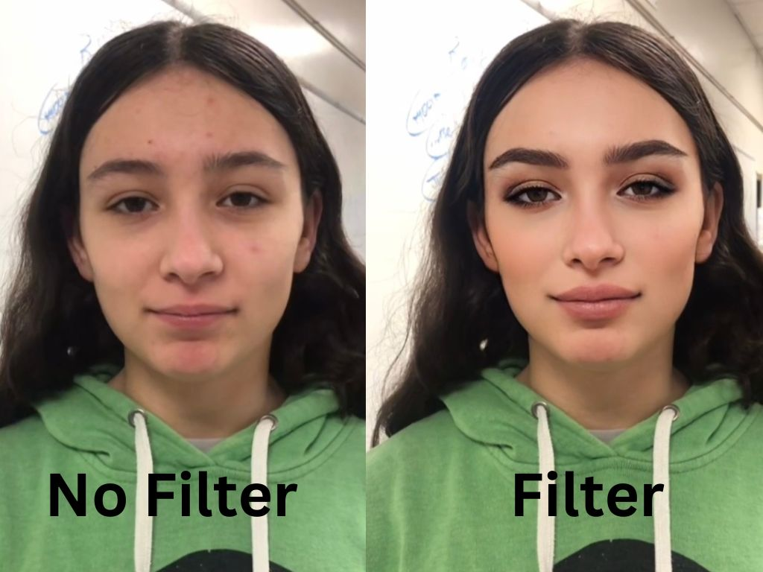

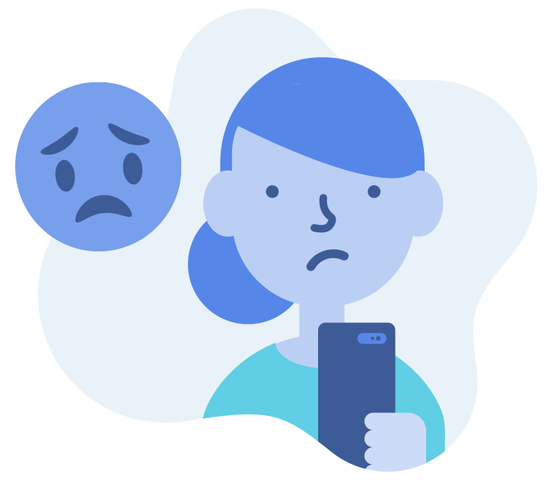
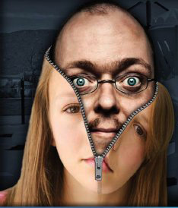


Task – Can you guess these social media risks – discuss with your parent/carer…
Notes:
CONTENT SLIDE

Slide 16
What are the risks of social media for children?
Oversharing – sharing too much personal information can help criminals/bullies/strangers/companies build a profile about your life, habits, interests…
Notes:
CONTENT SLIDE

Slide 17
What are the risks of social media for children?
Sharing your location – tagging photos with the geo-location, checking into venues, sharing journeys, location settings turned on, sharing images or videos that contain street names will reveal to everyone where you are!
Notes:
CONTENT SLIDE

Slide 18
What are the risks of social media for children?
Talking to people you don’t know – connecting with strangers and unknown users is always a risk. Are you certain you know and trust everyone you communicate with in Roblox, or in a WhatsApp group, or any social media platform?
Notes:
CONTENT SLIDE

Slide 19
What are the risks of social media for children?
Sending or receiving inappropriate content – children can be pressured into sharing harmful content (images, memes, videos of others without consent (leading to cyberbullying, worry and anxiety).
Notes:
CONTENT SLIDE

Slide 20
What are the risks of social media for children?
Unrealistic sense of body image or reality – influencers and celebrities will often share unrealistic images, videos and content on social media (to get clicks with the ‘perfect images or videos’).
Notes:
CONTENT SLIDE

Slide 21
What are the risks of social media for children?
Obsessive focus on likes and comments – children and adults often focus on likes or comments. This can leave them feeling that they aren’t good enough, upset or not as popular as someone else.
Notes:
CONTENT SLIDE

Slide 22
Supervision and parental controls
www.bridgend.gov.uk
www.bridgend.gov.uk
Notes:
START SLIDE

Slide 23
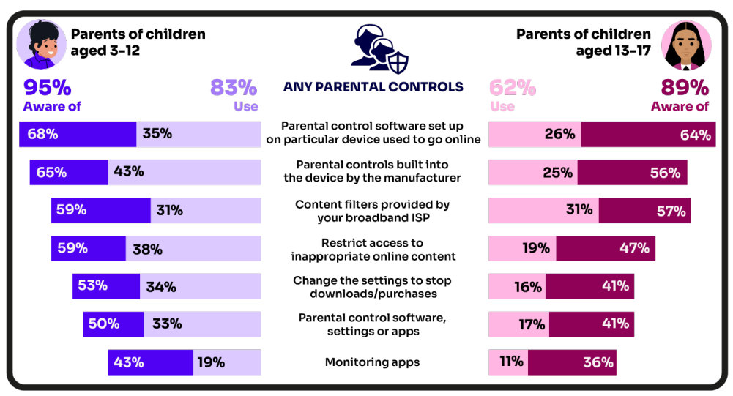
Are you AWARE of these PARENTAL CONTROL TOOLS?
Which ones have YOU USED?
www.bridgend.gov.uk
Notes:
CONTENT SLIDE

Slide 24
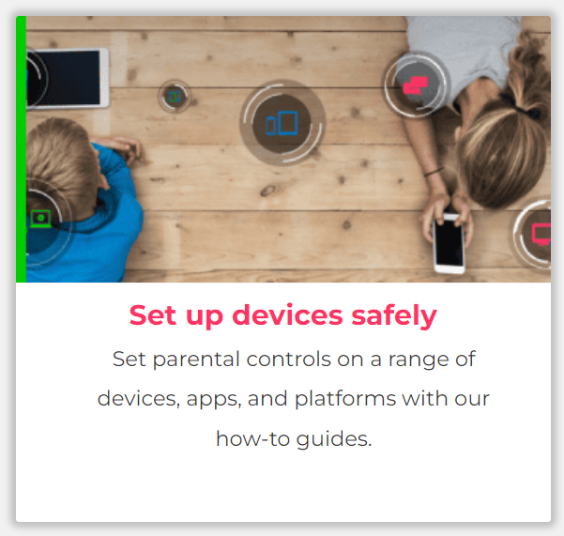
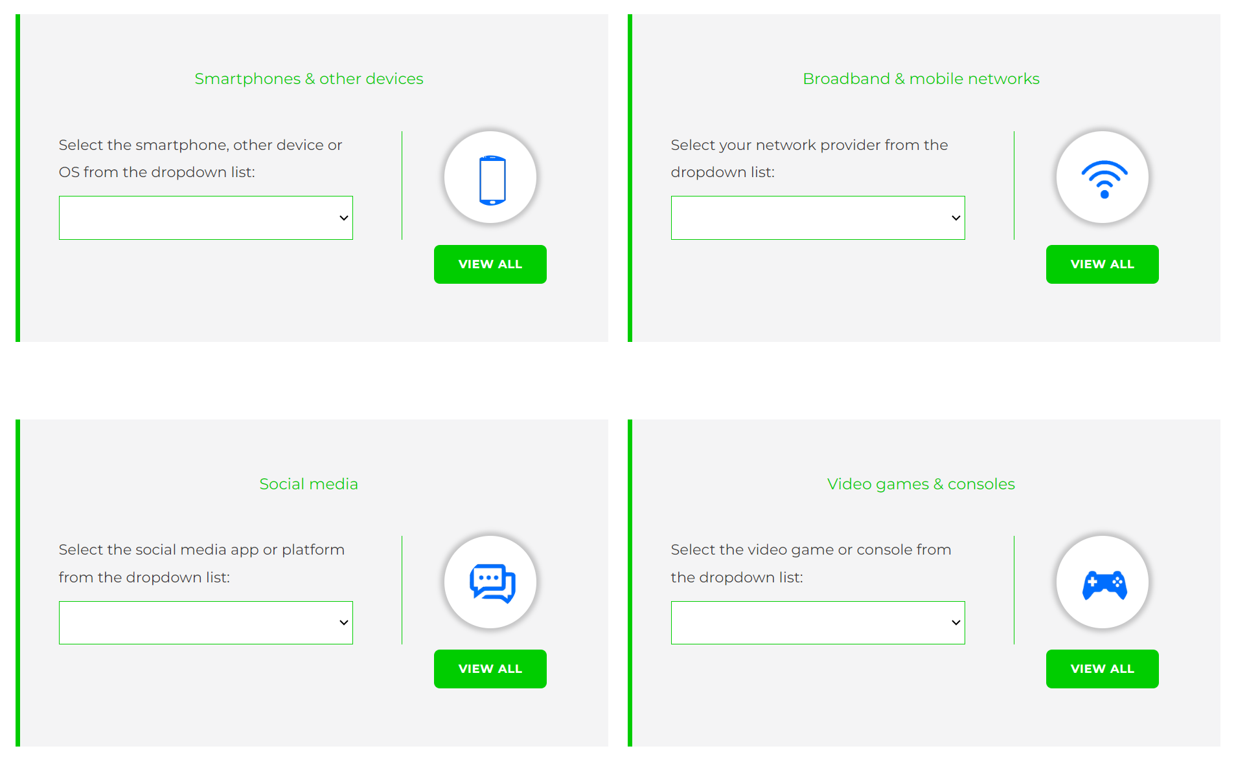
Visit internetmatters.org/parental-controls to find out how to set controls on devices:
www.bridgend.gov.uk
Notes:
CONTENT SLIDE

Slide 25
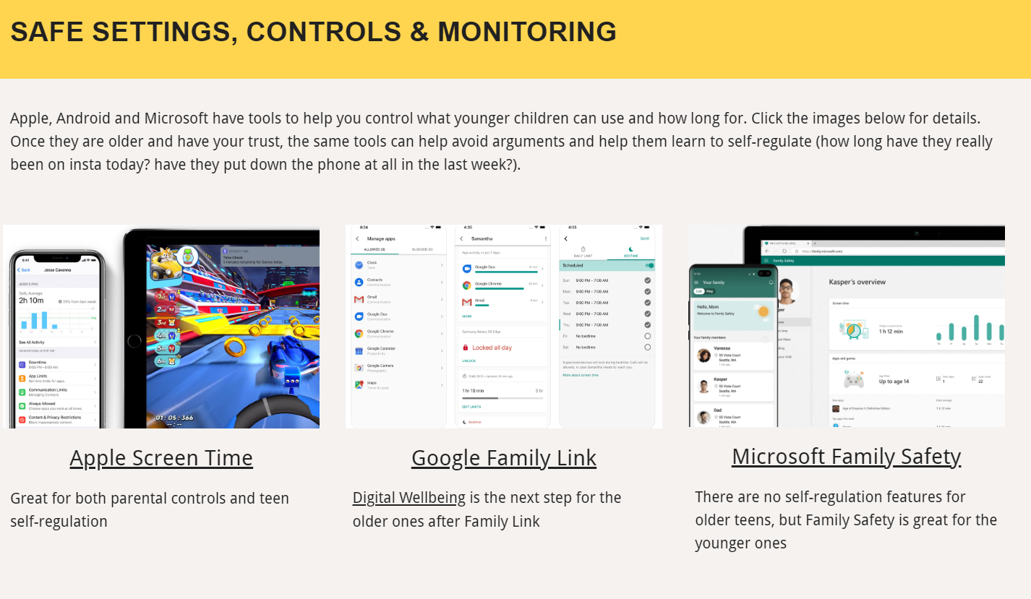
Parental control apps like Google Family Link, Screen Time and Microsoft Family can let you set limits across devices, apps and platforms
www.bridgend.gov.uk
Notes:
CONTENT SLIDE

Slide 26
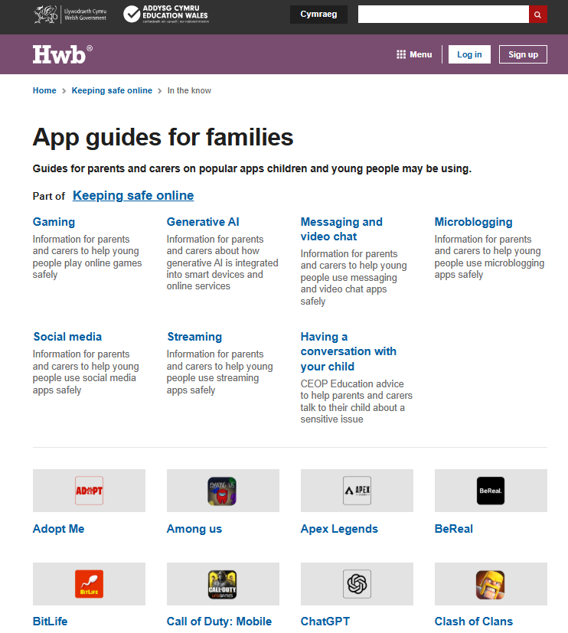
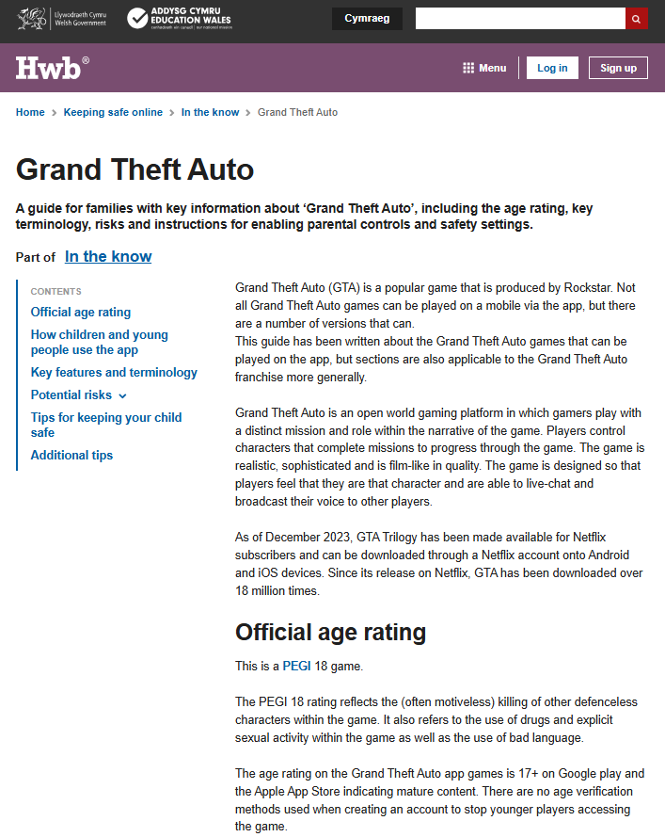
Hwb – Keeping Safe Online https://hwb.gov.wales/keeping-safe-online/in-the-know/
www.bridgend.gov.uk
Notes:
CONTENT SLIDE

Slide 27
What are our digital and
online responsibilities?
www.bridgend.gov.uk
www.bridgend.gov.uk
Notes:
START SLIDE

Slide 28

Task – What are PARENT-CARER digital and online responsibilities?
Monitor usage: Keep an eye on your child's social media activity and set time limits to prevent excessive use.
Educate: Teach children about online safety, privacy, and the potential risks of social media.
Set boundaries: Establish rules for social media use, including what is appropriate to share and who they can interact with.
Lead by example: Model healthy social media habits and be mindful of your own usage.
Communicate: Maintain open and non-judgmental discussions about social media experiences and challenges.
?
www.bridgend.gov.uk
Notes:
CONTENT SLIDE

Slide 29



What are CHILDREN’S digital and online responsibilities (with parent-carer support)?
Follow rules: Adhere to the guidelines set by parents regarding social media use.
Be respectful: Treat others with kindness and respect online, avoiding cyberbullying and negative behaviour – digital footprint!
Protect privacy: Be cautious about sharing personal information and understand the importance of privacy settings.
Report issues: Inform parents or guardians about
any uncomfortable or unsafe interactions online.
Balance time: Manage screen time effectively to ensure it doesn't interfere with other important activities like schoolwork and physical exercise.
?
www.bridgend.gov.uk
Notes:
CONTENT SLIDE

Slide 30
Family Agreement
www.bridgend.gov.uk
www.bridgend.gov.uk
Notes:
START SLIDE

Slide 31
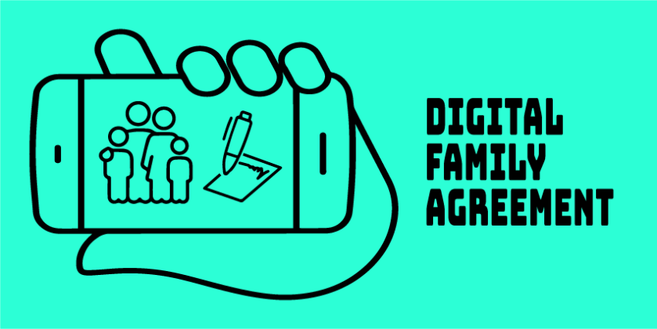
Task – Family Agreement
Create a shared set of online rules as a family to promote safe, respectful, and positive digital habits.
Talk together about the online experiences and concerns shown on the ‘Family Agreement’ template.
Agree on rules for time spent online, privacy, respect, and reporting issues – for example, setting screen time limits or agreeing not to share personal details.
Design and sign the agreement together.
Display it somewhere visible at home.
Review regularly to keep it relevant and celebrate positive behaviour.
www.bridgend.gov.uk
Notes:
CONTENT SLIDE

Slide 32
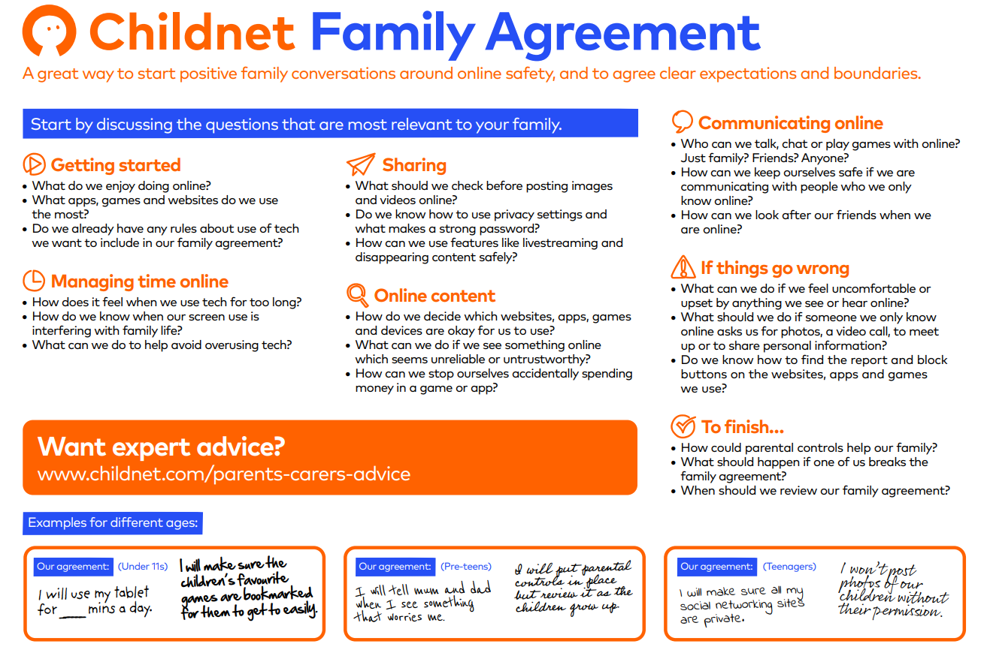
www.bridgend.gov.uk
Notes:
CONTENT SLIDE

Slide 33
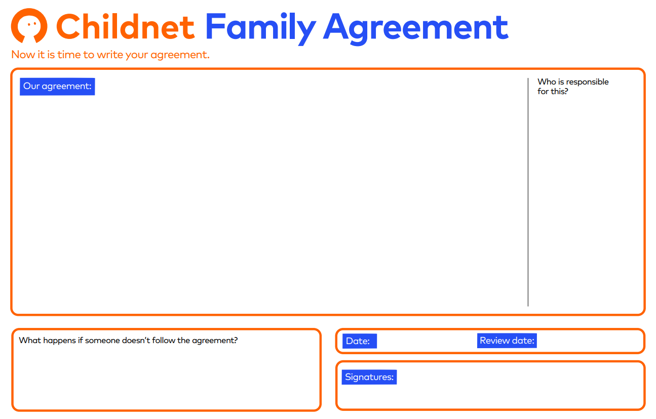
www.bridgend.gov.uk
Notes:
CONTENT SLIDE

Slide 34
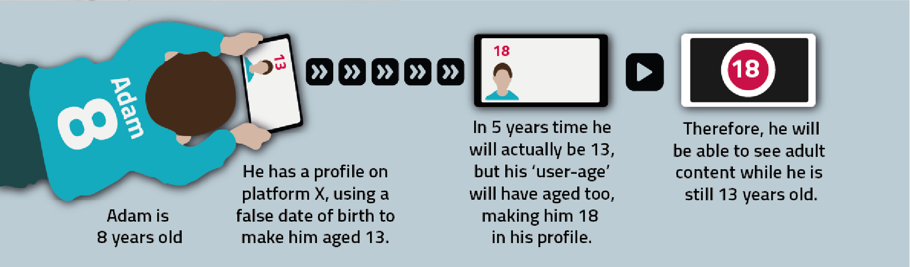
Final thoughts… (critical thinking…)
What are the consequences for Adam?
?
www.bridgend.gov.uk
Notes:
CONTENT SLIDE

Slide 35
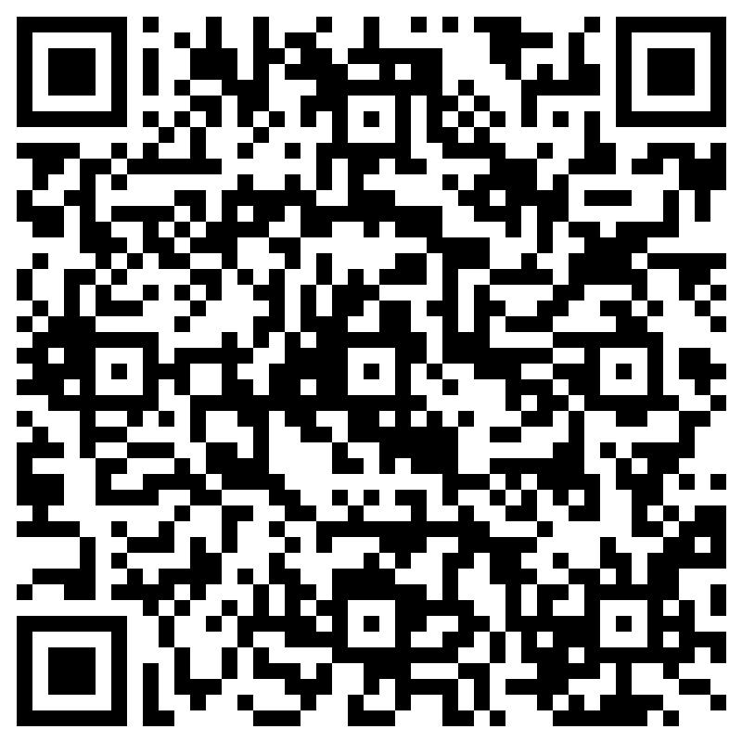
For further support contact: Mat Jones Swyddog Arweiniol ar gyfer Dysgu Digidol (Grŵp Ysgolion) Lead Officer for Digital Learning (Schools Group) Y Gyfarwyddiaeth Addysg, Blynyddoedd Cynnar a Phobl Ifanc Education, Early Years and Young People Directorate Cyngor Bwrdeistref Sirol Pen-y-bont ar Ogwr Bridgend County Borough Council Email: mathew.jones@bridgend.gov.uk Website: www.bridgend.gov.uk Phone: (01656) 643558
Please scan to provide learning event feedback
www.bridgend.gov.uk
Notes:
CONTENT SLIDE

Slide 36
edsu@bridgend.gov.uk
www.bridgend.gov.uk
www.bridgend.gov.uk
Notes:
START SLIDE

