Slide 1

Croeso i Ysgol Gynradd Cwmfelin
Eager to Learn. Proud to Achieve
Awyddus I Ddysgu. Balch I Gyflawni
Meet the teacher

Slide 2

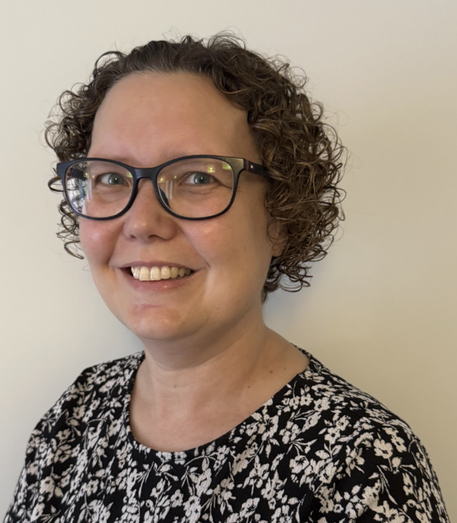
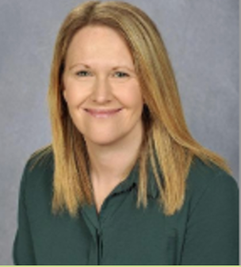

Meet the team
Class Teacher –Mrs A. Morris
LSO– Mrs L. Sykes
LSO– Miss J. Walters

Slide 3
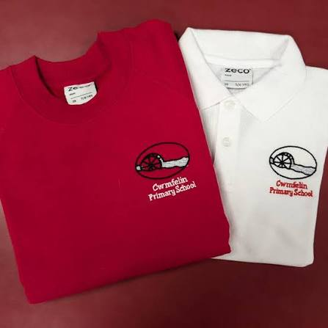
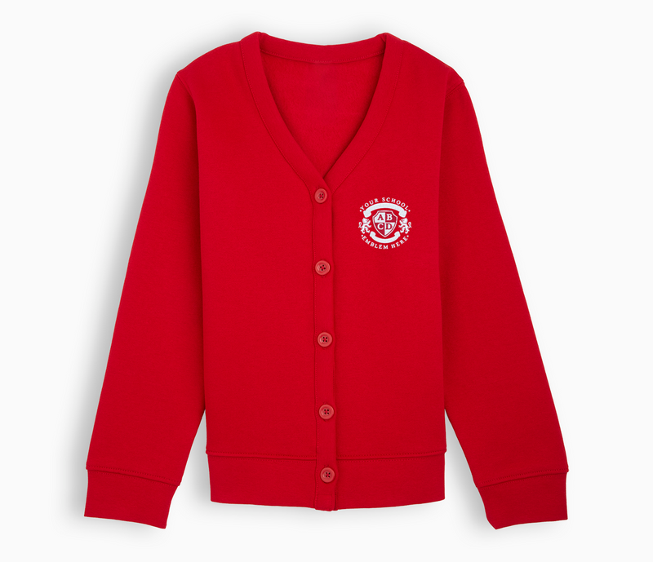
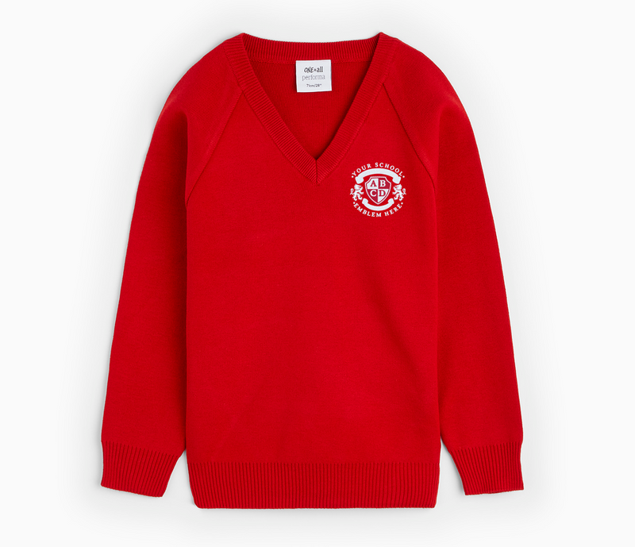
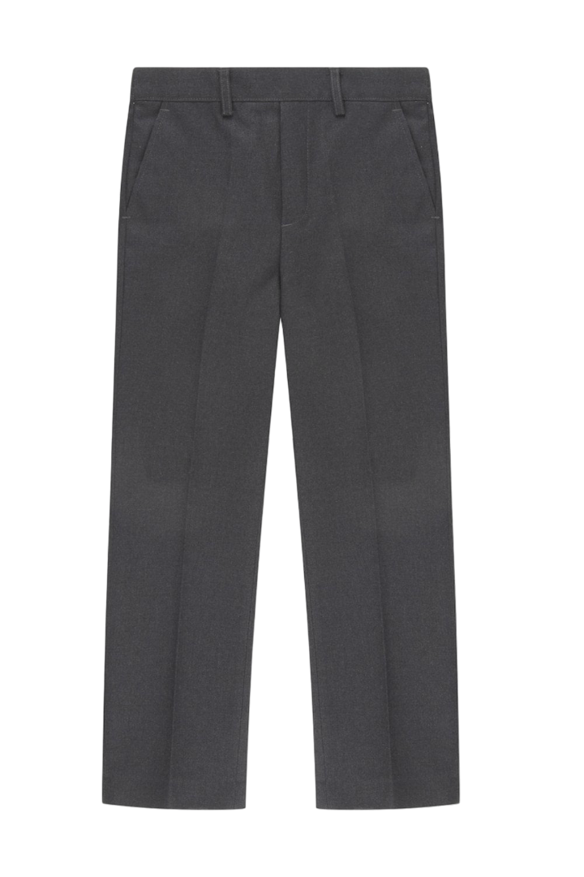
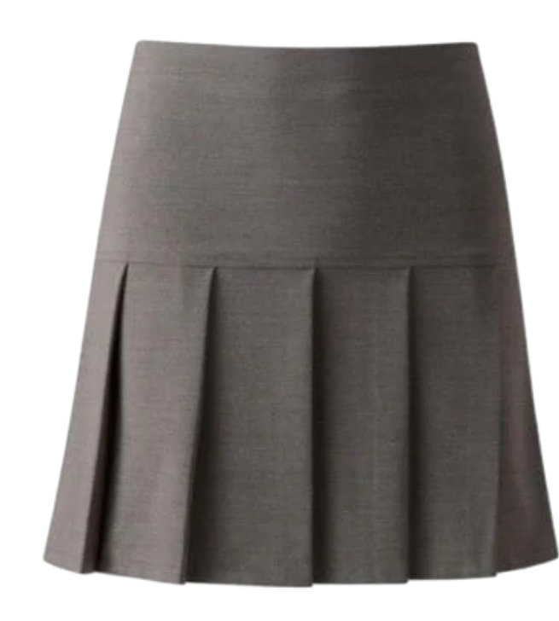
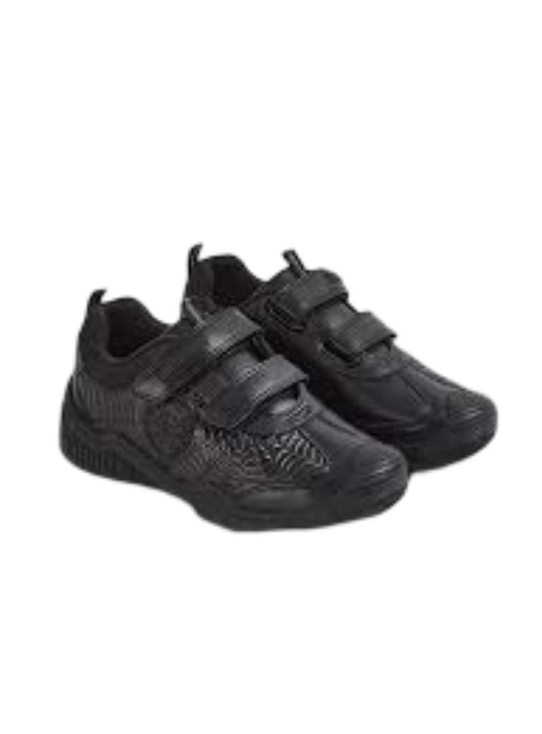
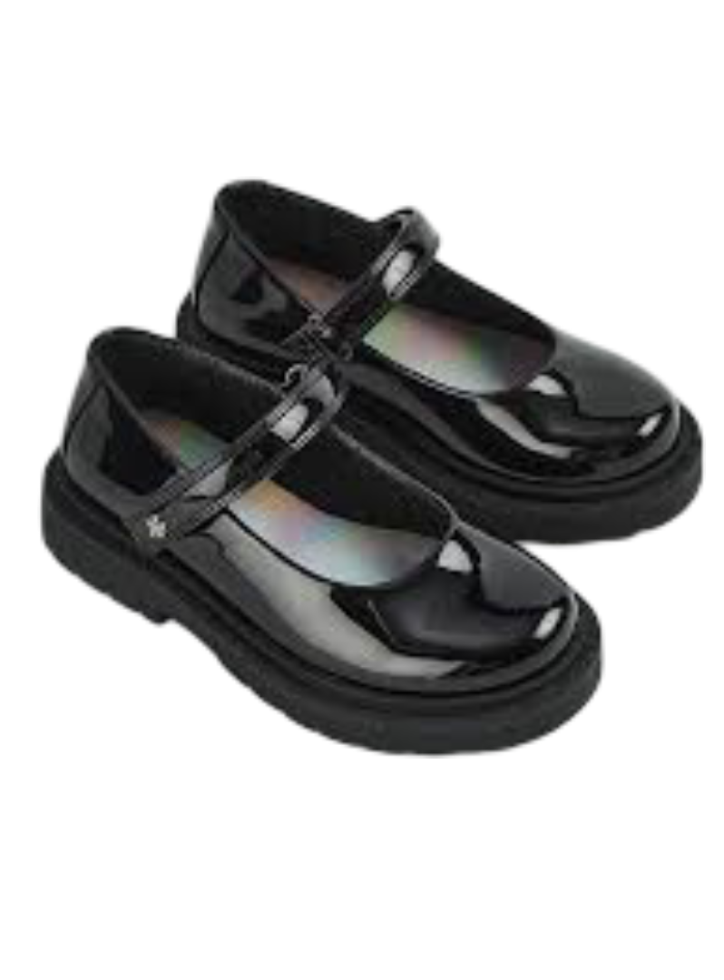
Uniform Expectations
White or Red Polo Shirt
Red school jumper or cardigan
Grey trousers or skirt
PE – Monday.
Nursery and Reception can come dressed in PE kit
Black tracksuit bottoms
Trainers
Black shoes

Slide 4

You are also able to order uniform by using the form located on the Cwmfelin website.

Slide 5
Curriculum
Cwmfelin Primary School’s medium term inquiry overviews for the year are available to view on our website.
We teach through an inquiry-based learning approach which encourages children to be curious, ask questions, investigate ideas, and discover answers through hands-on learning. Rather than simply being told information, pupils actively explore topics, solve problems, and develop important skills such as critical thinking, creativity, communication, and independence.
This approach helps children become motivated, confident learners who take ownership of their learning.

Slide 6
Family Engagement
Throughout the year, there will be opportunities for parents and family members to come into school and take part in Reading and Maths Cafés, where you can work alongside your child and support their learning.
We will also hold at least one showcase during the year, giving you the opportunity to come into school, see your child’s learning and celebrate their achievements with them.

Slide 7
What does my child need to bring to school?
A labelled water bottle
2. A healthy snack
3. A packed lunch (if needed)
4. My reading book.
Please ensure all belongings are clearly labelled

Slide 8
Healthy Schools
Cwmfelin promotes the children’s right to be healthy.
Please take a look at our Food and Fitness policy to familiarise yourself with our school expectations.
Children must bring a plastic bottle to school to access fresh water throughout the day. Squash, flavoured water or other drinks are not permitted.
Please provide a healthy snack (fruit or vegetables) which the children will be encouraged to eat mid morning.
Milk is also provided daily.

Slide 9
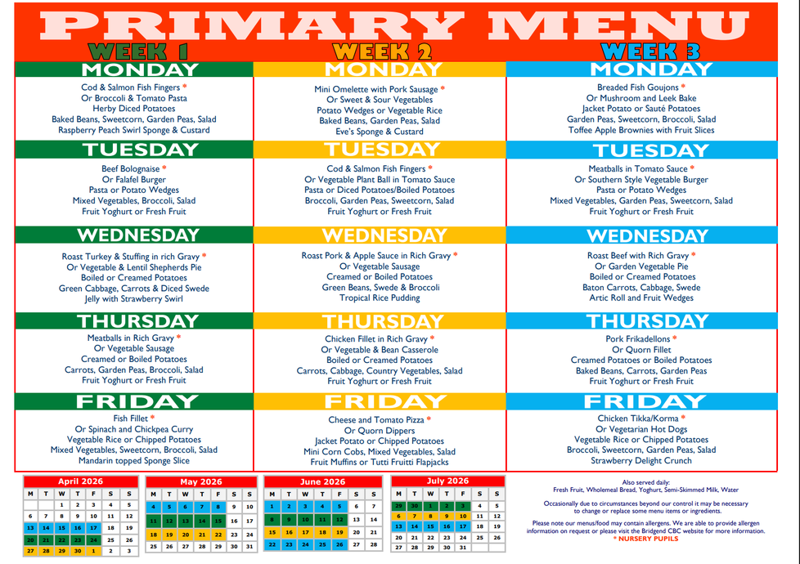
School Meals
School Dinner is free for pupils. The school dinner menu can be viewed on the Cwmfelin Primary School website.
Pupils receive a main meal, dessert and a cold drink.
Nursery pupils have one option, which is indicated on the primary school menu by an asterisk.
The menus are on a three-week rotation.

Slide 10
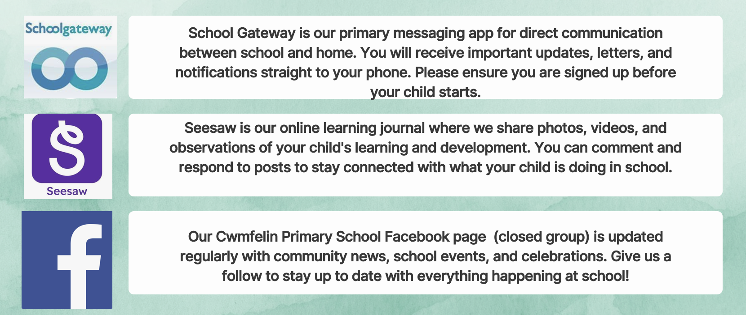
Communication

Slide 11

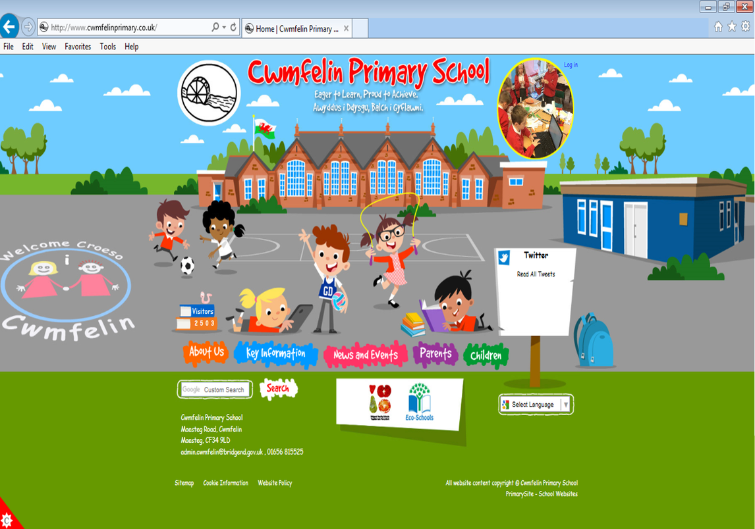
School Website & Policies
All key school policies and documents are available on our school website.
We encourage all parents and carers to familiarise themselves with these important resources.
Website: www.cwmfelinprimary.co.uk
Key policies available online:
• Admissions Policy
• Safeguarding & Child Protection Policy
• Behaviour & Wellbeing Policy
• Healthy Schools Policy
• Attendance Policy
• SEND Information Report
If you have any difficulty accessing documents, please speak to the school office and we will be happy to provide a printed copy.

