Slide 1

Cwmfelin Primary School
Nursery September 2025

Slide 2
Welcome to Cwmfelin
Hello and Welcome to Nursery!
During this presentation you will find out information about our Early Years Department.
We are very excited to welcome your children to Cwmfelin.

Slide 3
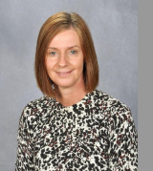
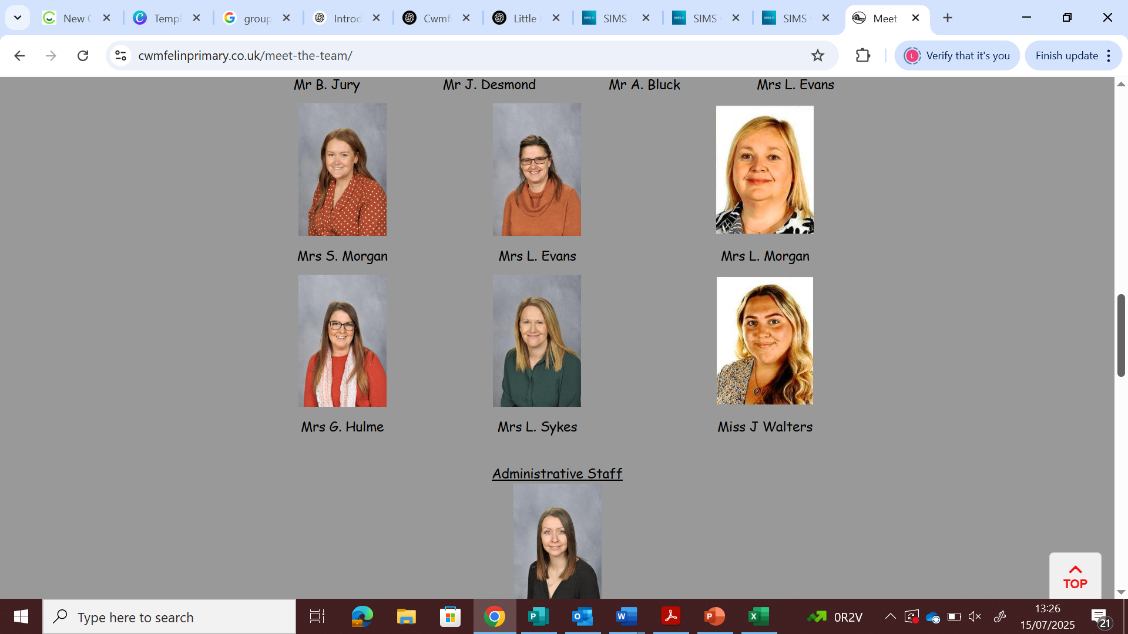
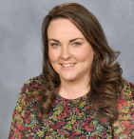
Staff
Mrs J. Edwards
Acting Headteacher
Mrs L Evans Teacher/ Acting Assistant Headteacher
Mrs G Hulme LSO
Mrs L Sykes LSO
Miss J Walters LSO

Slide 4
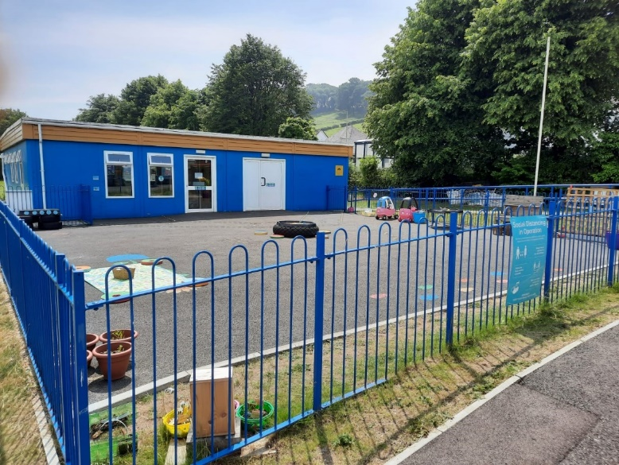
Need an up to date photo here
Our learning environment
Our Early Years unit includes two buildings, The Willows and the Rainbow room which has an enclosed yard with direct access from the classroom. We use the outdoor environment for lots of our learning opportunities and have full access to the school field.

Slide 5
How we use the outdoors
We go outside in all weathers to explore the world around us and the changing seasons. Children wear wet weather suits when it’s raining which are provided by the school. We ask for wellies to be brought in and left in school as we may go out for different lessons.
Den building
Parachute games
Riding bicycles and scooters
Gardening
Literacy tasks – writing with chalks, mud painting, retelling stories
Numeracy – counting natural objects, comparing sizes and shapes in the environment, and looking for numbers around school.
These are just a few of the wonderful outdoor
opportunities that we provide.

Slide 6
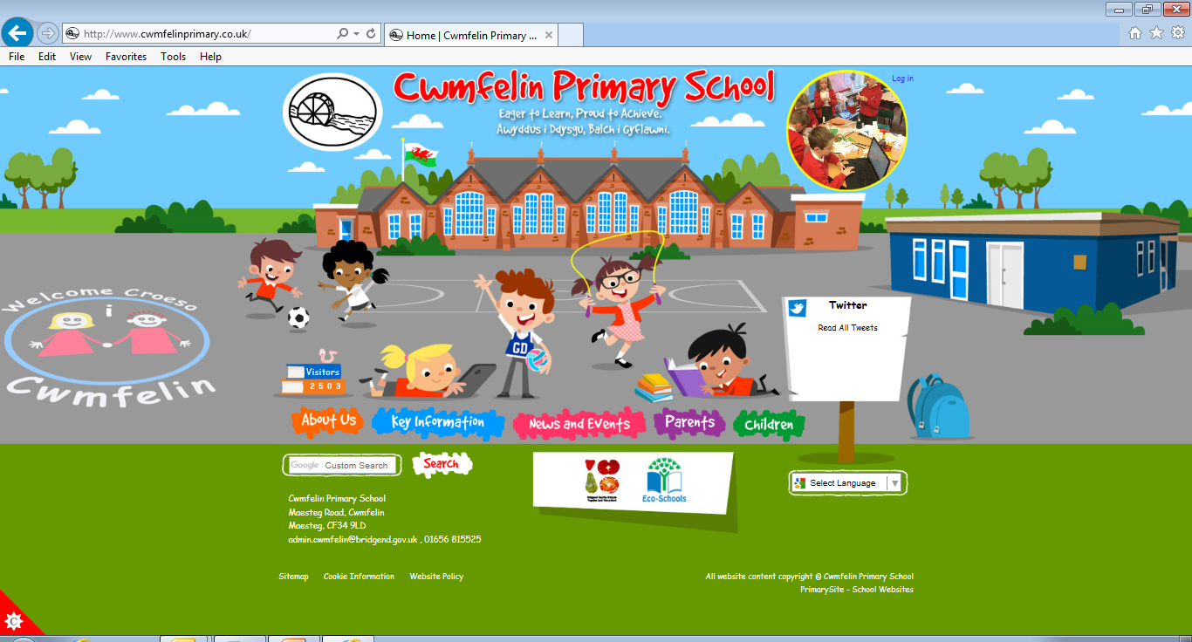
Cwmfelin Website
Important School Policies are available on our website.
Please ensure that you familiarise yourself with our school policies to avoid any possible misunderstandings.

Slide 7
Uniform
Please refer to the School Uniform Policy on our website:-
https://www.cwmfelinprimary.co.uk/policies/
Important: Please ensure all items of clothing are clearly marked with your child’s name.

Slide 8
Healthy Schools
Cwmfelin promotes the children’s right to be healthy. Please take a look at our Food and Fitness policy to familiarise yourself with our school expectations.
Children must bring a plastic bottle to school to access fresh water throughout the day. Squash, flavoured water or other drinks are not permitted. Please provide a healthy snack (fruit or vegetables) which the children will be encouraged to eat mid morning. Milk is also provided daily.
https://www.cwmfelinprimary.co.uk/policies/

Slide 9
How you will receive information.
School Gateway is our main form of communication with parents. It allows us to send text messages and emails to you directly. All information will be shared via this app which can be downloaded free to any device. It also offers flexible payment options for school trips/visits.
Facebook: Cwmfelin Primary School (closed group)
The Big Bocs Bwyd @ Cwmfelin Primary School
School always seeks parental permission before sharing photographs on social media. Forms can be found in your pack.

Slide 10
Seesaw
We use Seesaw on a daily basis to record pupil tasks and achievements. As parents, you will be granted access to your child’s seesaw account which will be set up on the first day that your child starts school.
Seesaw is available on a computer, or as an app on a tablet, computer or smart phone. The app is free to download.

Slide 11
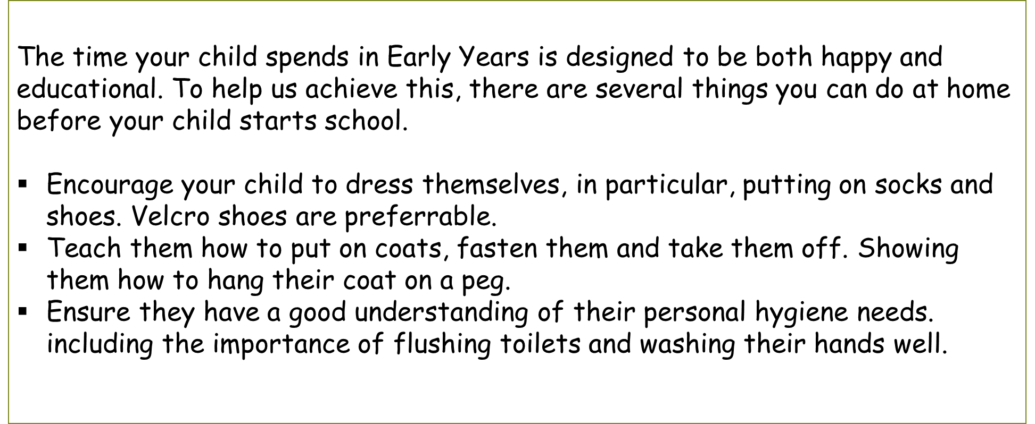
How you can help at home

Slide 12
Ensure that your child is toilet trained. We understand that accidents may occur from time to time so please provide a change of clothing in their bag. Occasionally we may need to ring home if required.
Show and encourage your child to use cutlery correctly, sitting at the table to eat.
We understand that the children are very young and all develop at different stages, but your assistance with the above will be both beneficial to your child and helpful to us.

Slide 13
Start date
Children will start at 9am and will finish at 3pm. Late arrivals should report to the office and sign in. We encourage parents to be punctual as lateness often disrupts learning.
Please complete the relevant forms in your pack and return to school on the first day.
The start date for children is: Thursday 4th September

Slide 14
Any questions?

